Slide 1

INNOVATION & ENTREPRENEURSHIP
Transport & Mobility
Routing Algorithms
Jobs to Be Done Analysis
Domain: Transportation & Mobility | Job: Efficient Mobility
Team 4: Michael, Jason, Jonathan, Sichen
1
Notes:
Slide 1: Cover
What this slide is doing:
- Introduces the domain, transportation and mobility, and names the single job we chose to analyse: transport with efficiency.
- Signals the method: Jobs to Be Done, which separates the job from the current solution.
Core idea to understand:
- A job is the progress someone is trying to make. It stays the same even when the solution changes.
- People do not want a scooter or a map app. They want to get from where they are to where they need to be with as little time, cost and effort as possible.
Scope note if asked:
- We mapped the travel itself, door to door. Deciding to go and booking are out of scope, so the steps we rate run from leaving the origin to arriving at the destination.
Transition:
- The next slide shows what the job is up against today.

Slide 2
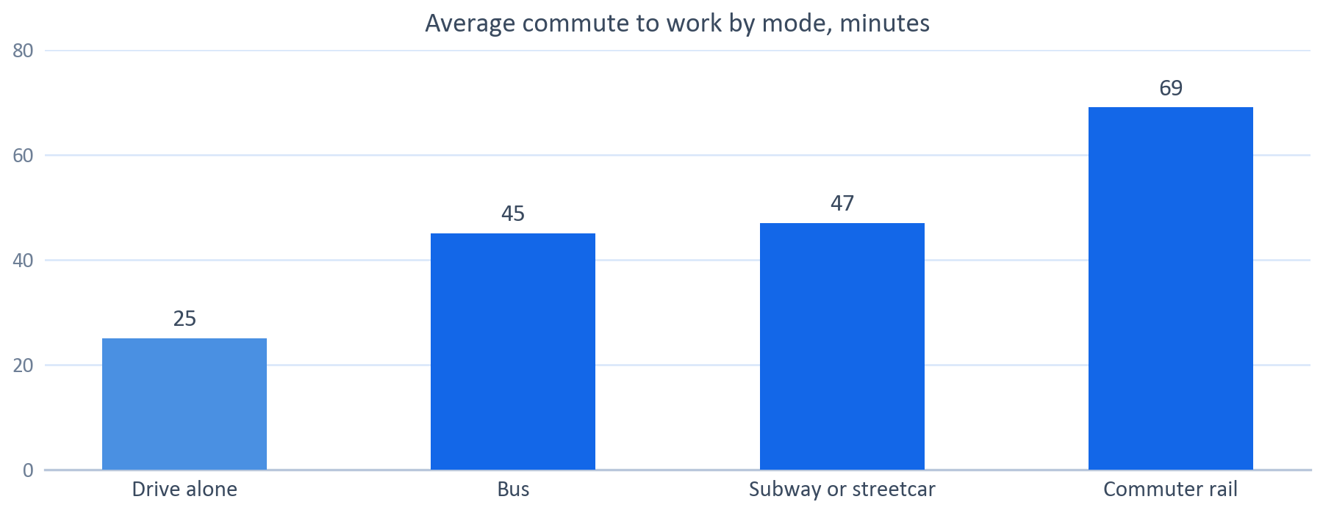




INNOVATION & ENTREPRENEURSHIP
Domain + Relevant Data
What is the job?
Going from point A to point B with as little time, cost and effort as possible
Today we use routing applications, Google Maps and Waze that prioritize for speed with relatively simple algorithms to modern standards
These simple algorithms have largely remained unchanged for decades
Additionally, every individual wants to optimize on different things during their route, including safety, sights, emissions, and more; many of these are not taken into account in today’s paradigm of routing applications
49 hours
10 min
80%
70%
Lost to congestion per US driver in 2025, up six hours in a year (~$894 each driver, $85.8bn nationally)
Average transit wait.
How often a 5 minute transfer window actually takes 5 minutes.
Of US navigation app users are on Google Maps, with Waze at 27% and Apple Maps 25%
Sources: INRIX 2025 Global Traffic Scorecard (Dec. 2025); Governing analysis of American Community Survey and National Household Travel Survey commute data; Bick, Journal of Public Transportation Vol. 14 No. 3; 2022 NextGen National Household Travel Survey.
2
Notes:
Slide 2: Domain + Relevant Data
Framing the job:
- We restated the job to strip the solution out of it. The original phrasing, transport with efficiency using scooters and maps, had the answer baked into the question.
- What the job implies we should measure: elapsed door-to-door time rather than vehicle speed, predictability, and footprint per person moved rather than per vehicle.
How to read the chart:
- Average one-way commute times by mode: about 25 minutes driving alone, 45 by bus, 47 by subway or streetcar, 69 by commuter rail.
- These are national averages from Census commute data and do not control for distance, so they are an illustration of the door-to-door penalty rather than a controlled comparison.
- The point is that the gap is not explained by vehicle speed. A bus is not half as fast as a car.
Why the metric cards matter:
- 49 hours lost per driver in 2025, up six hours in one year, worth about $894 each and $85.8 billion nationally. Congestion rose in 88% of the 290 US cities measured.
- Transit wait averages around ten minutes, and once you add the walk to and from stops, the non-riding portion of the trip is longer than the ride.
- A five-minute transfer window holds only about 80% of the time, so travelers arrive early and pad their schedules. That padding is time spent that no system counts.
- Average occupancy is 1.5 persons per trip. On the environmental half of this job, filling seats matters more than changing what the vehicle burns.
Interpretation:
- Every solution the team listed optimizes the moving segment. None of them owns the waiting, transferring or walking.
Transition:
- To find where the job is underserved, we mapped how it gets done today and rated each step.

Slide 3

INNOVATION & ENTREPRENEURSHIP
Analysis: Jobs to Be Done
Separate the job from the solution, map how it gets done today, and rate each step by importance and satisfaction
THE JOB
DESIRED OUTCOME
TODAY
Going from point A to point B
Arrive quickly, predictably, safely, comfortably, cheaply...
Google Maps • Waze • TomTom • Car • Train • Bus • Subway • Plane • Taxi • Uber/Lyft…
Jobs to be done for today’s trips
1
2
GAP
3
4
5
GAP
6
7
GAP
Walking to the vehicle/stop
Waiting for transport or in traffic
Boarding and paying
Riding/driving (in motion)
Transferring
Walking to the final destination
Parking or returning the vehicle
IMPORTANCE
IMPORTANCE
IMPORTANCE
IMPORTANCE
IMPORTANCE
IMPORTANCE
IMPORTANCE
SATISFACTION
SATISFACTION
SATISFACTION
SATISFACTION
SATISFACTION
SATISFACTION
SATISFACTION
Areas to Address: waiting for transport or in traffic, transferring, and parking
3
Notes:
Slide 3: Analysis — Jobs to Be Done
What the method does:
- A job is the progress a person seeks in a circumstance. It is not the product. People do not want a quarter-inch drill, they want a quarter-inch hole.
- Separating the job from the current solution matters because the job stays stable while solutions change. Scooters, map apps and robotaxis are all current solutions to the same job.
- Once the job is clean, you map how it gets done today and rate each step on importance and satisfaction. Steps that are important and unsatisfying are underserved, and that is where the opportunity sits.
How we restated the job:
- Our first phrasing was transport with efficiency, with scooters and Google Maps as the current solution. That phrasing had the solution inside it.
- Restated: get from where I am to where I need to be with as little time, cost and effort as possible, without the trip costing more than it should in emissions.
Scope of the map:
- We mapped the travel itself, door to door. The traveler has already decided to go and chosen a mode, so the steps run from leaving the origin to arriving.
Reading the ratings:
- Importance and satisfaction are rated one to five. The gap between them is what matters, not either number alone.
- Waiting: importance five, satisfaction two. Average transit wait is around ten minutes, and with the walk to and from stops the non-riding portion outlasts the ride.
- Transferring: importance four, satisfaction one. The lowest score on the map. A five-minute transfer window holds only about 80% of the time, and transfers are a major source of travel time variability.
- Parking or returning the vehicle: importance four, satisfaction two. Studies of congested downtowns have found roughly 30% of cars cruising for parking, with search times around eight minutes. Treat that figure carefully; it is for congested downtown traffic, not all urban traffic.
- Board and pay scores well. It is a step the industry has already solved, which is useful contrast: it shows the ratings are discriminating rather than uniformly negative.
The main finding:
- All three underserved steps sit between modes rather than inside one. Every current solution owns a single mode, so nobody owns the handoffs. That is the gap the next slide works from.

Slide 4



INNOVATION & ENTREPRENEURSHIP
Opportunities
Problems current navigation tools don’t address, each tied to a step on the previous slide.
Acts on: Park
GAP
Acts on: Wait + Transfer
GAP
Know the Curb Before You Arrive
The Train Everyone Knows Is Late
Problem:
Navigation ends at the address, not at a legal place to stop. Drivers find out on arrival.
Problem:
Riders know which trains run late and which connections fail; the app still shows the schedule.
Why it matters:
When San Francisco priced curbs by demand, average parking search time fell 43%.
Why it matters:
One operator’s on-time figure fell from 96% to 94.8% once two counting allowances were dropped.
Acts on: Before you drive
Acts on: Ride or drive
Construction You Can See Coming
Routes That Weigh More Than Time
Problem:
Work zone feeds start once a zone is active; the permit behind it existed weeks earlier.
Problem:
Routing ranks by time and past crashes; travelers cannot weigh risk, light or a child on board.
Only 40 work zone feeds were active nationally as of June 2026.
An 8% faster route was found to carry 23% higher crash probability, a trade-off made silently.
Why it matters:
Why it matters:
The common fault: routing runs on what already happened, reports the scheduled world, stops at the address, and optimizes one number.
Sources: SFMTA, SFpark evaluation (June 2014); Walker, Human Transit (2010); CBS News Chicago on Metra on-time reporting; US DOT Volpe Center, Work Zone Data Exchange; Sohrabi and Lord, Texas A&M, Transportation Research Part C (2022).
4
Notes:
Slide 4: Opportunities
What this slide is doing:
- Four problem spaces, not product pitches. Each card names the step on slide 3 it acts on.
- The two top cards act on steps the ratings marked as gaps: parking, and waiting plus transferring. The two bottom cards act on the ride or drive step, which rated better, so present them as supporting ideas.
- They share one fault: routing runs on what already happened, reports the scheduled world, stops at the address, and optimizes a single number.
Know the curb before you arrive (step 7, park or return):
- Navigation guides you to an address pin, not to a place where stopping or parking is legal. Drivers learn the curb rules on arrival, when they have the fewest options.
- Google Maps predicts parking difficulty, but does not say whether a space is open or legal. Several cities, such as Boston and Seattle, are only now turning curb rules into machine-readable data using the open Curb Data Specification.
- Evidence that the step can improve: in San Francisco’s SFpark evaluation (June 2014), demand-based curb pricing cut average parking search time by 5 minutes, or 43%, against control areas.
The train everyone knows is late (steps 2 and 5, wait and transfer):
- On-time performance counts trains, not riders, so an empty late-night run offsets a packed peak one.
- The definition of on time is a choice: about five minutes in many systems, ten at King County Metro. A ten-minute tolerance on a thirty-minute trip permits a 33% overrun that still counts as on time.
- Metra did not count non-peak trains delayed five to ten minutes in construction zones as late, and automatically counted special-event trains as on time. Dropping both moved one month from 96% to 94.8%.
- The pattern a commuter recognises already exists in historical arrival data. It is simply not in what the app shows.
Construction you can see coming (before the drive):
- The Work Zone Data Exchange has existed since 2020 and feeds navigation providers, but only 40 feeds were active as of June 2026.
- A work zone feed describes a zone that is already active, which is roughly when traffic reveals it anyway. The permit authorising the work existed weeks earlier, with a city or state agency, outside the chain.
- Honest difficulty: permit systems are municipal and fragmented, and a permit date is a plan rather than a start date.
Routes that weigh more than time (step 4, ride or drive). This card merges the earlier risk and dial ideas:
- Texas A&M compared shortest and safest routes across more than 29,000 road segments in five Texas metro areas. A route with 8% shorter travel time carried 23% higher crash probability.
- Travelers want different weightings at night, with a child or on a bike, but the interface exposes mode choice and little else.
- Caution: a 2012 Microsoft patent for routing around high-crime areas was criticised as digital redlining. Define safety with road-level evidence such as crash risk, lighting and sidewalk presence, not neighborhood crime data.
Closing interpretation:
- None of these is solved by a better scooter, a faster bus or a driverless car. They are problems of inputs and objectives in the layer that directs the trip.

